Slide 1
Cold Chain Analysis Cost
An Analytical Study on Investment and Subsidy Patterns
Student Name: Krunal Dhapodkar
PRN: 22070521006
Semester: 7
Subject: Data Science
Mentor: Dr. Piyush Chauhan
Notes:
Welcome to the presentation on Cold Chain Analysis Cost, a data-driven examination of investment efficiency, subsidy allocation, and predictive modeling in India’s cold chain infrastructure. This project explores nearly 4,500 analyzed projects and uncovers the economic and geographic dynamics shaping cold chain development.
Presented by Krunal Dhapodkar, a 7th semester student of Data Science, this work is conducted under the mentorship of Dr. Piyush Chauhan. The analysis aims to integrate statistical insights with business and policy implications to drive smarter infrastructure investment.
Throughout this presentation, we’ll see how machine learning, geospatial analysis, and investment data come together to create a comprehensive understanding of cold chain cost efficiency and performance.

Slide 2
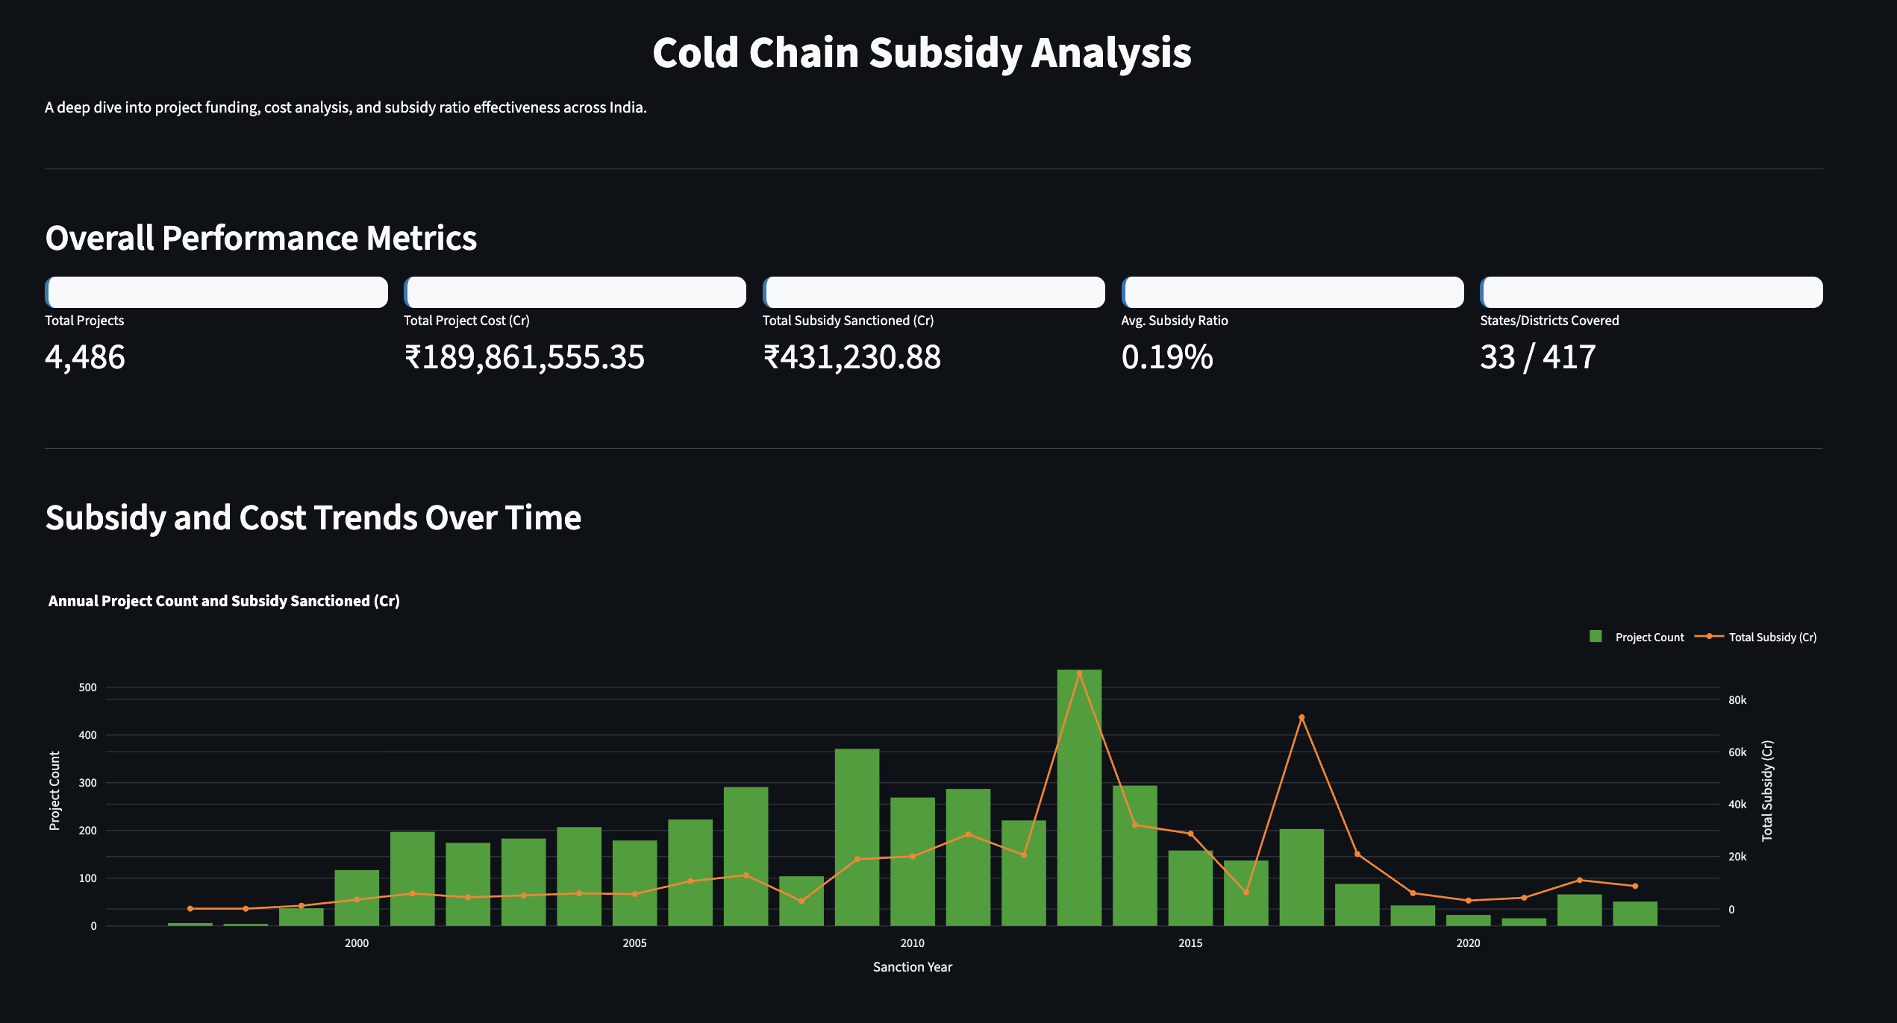
Projects Analyzed: A total of 4,486 cold chain projects were analyzed across India, covering a diverse range of agricultural and industrial contexts.
Total Investment: ₹189,861,555.35 Crores invested across all projects, representing substantial nationwide infrastructure deployment.
Subsidies Sanctioned: ₹431,230.88 Crores in government subsidies allocated, indicating limited but strategic financial support.
Average Subsidy Ratio: Only 0.19% of total project cost covered by subsidies, reflecting high private investment efficiency.
Geographic Coverage: 33 states and districts represented from a total of 417 administrative regions, signifying broad but uneven reach.
Notes:
This slide summarizes the key performance metrics of India's cold chain development initiatives. Over 4,400 projects were analyzed, revealing a massive ₹189 trillion in total investments, demonstrating strong industrial commitment to cold logistics. Yet, the government subsidy contribution remains modest—just 0.19% of total costs—implying efficient private-sector engagement.
Geographically, 33 states and districts are represented, though coverage is uneven, highlighting potential policy gaps. This macro-level performance view establishes the foundation for deeper temporal, geographic, and predictive analyses in the following slides.
In essence, India’s cold chain ecosystem operates with high efficiency and limited dependency on public financing—an encouraging sign for sustainable industrial growth.

Slide 3
Cold Chain Investment Patterns Over Time
Temporal Analysis of Subsidy and Cost Trends
Peak Investment Period: The years 2012–2013 marked the highest project counts and subsidy allocations, coinciding with major policy interventions.
Growth Phase: Between 2008 and 2013, cold chain projects expanded rapidly as funding programs and awareness increased.
Decline Phase: After 2014, the number of new projects sharply declined due to reduced policy incentives and market saturation.
Recent Trend: Minimal investment activity during 2020–2022, attributed to COVID-19 disruptions and fiscal prioritization shifts.
Policy Correlation: Investment peaks align closely with government policy initiatives, confirming their catalytic impact on infrastructure development.
Notes:
This timeline-based analysis reveals the evolution of cold chain investments over more than a decade. The most active period occurred between 2008 and 2013, when policy incentives and awareness led to a surge in project approvals. The year 2012–2013, in particular, stands out as the apex of both project count and subsidy flow.
Post-2014, however, the system entered a slowdown phase. Policy recalibrations, fiscal tightening, and market saturation led to a noticeable decline in new investments. This pattern underscores the importance of sustained government engagement to maintain momentum.
The 2020–2022 stagnation further reflects external shocks, such as the pandemic, that affected capital allocation and logistics expansion. Overall, the data shows how policy timing directly influences industrial activity in India’s cold chain sector.

Slide 4
State-wise Project Distribution & Subsidy Allocation
Geographic Distribution Analysis
Leading States by Projects: Uttar Pradesh leads with 1,400+ projects, followed by Gujarat (600+) and Punjab (500+), indicating strong regional participation.
Leading States by Subsidies: Uttar Pradesh tops with ₹80+ Cr, Maharashtra with ₹60+ Cr, and Gujarat with ₹50+ Cr, showcasing alignment of investment and support.
Regional Focus: Northern and Western regions dominate cold chain infrastructure growth, linked to agricultural productivity zones.
District-Level Highlights: Guntur (Andhra Pradesh) emerges as a major district-level hub, receiving over ₹8,000 Cr in subsidy allocations.
Strategic Insight: The geographic clustering reflects targeted development policies around agri-supply chains and export corridors.
Notes:
This slide visualizes how cold chain investments are geographically distributed across India. The data reveal a clear regional bias, with Uttar Pradesh, Gujarat, and Punjab leading the national effort in both project numbers and subsidy amounts. This distribution closely follows India’s agricultural and food processing belts, where cold chain infrastructure has the most immediate impact.
Interestingly, the state of Uttar Pradesh not only tops in project count but also in total subsidy allocation—over ₹80 Crores—indicating efficient project execution and strong state participation. Meanwhile, Guntur district in Andhra Pradesh stands out as a district-level powerhouse, receiving an exceptional ₹8,000+ Crores in subsidies.
Such concentration of resources in Northern and Western India underscores the need for balanced growth. Future policies could focus on expanding infrastructure in underrepresented regions, such as the East and South, to strengthen national cold chain coverage.

Slide 5
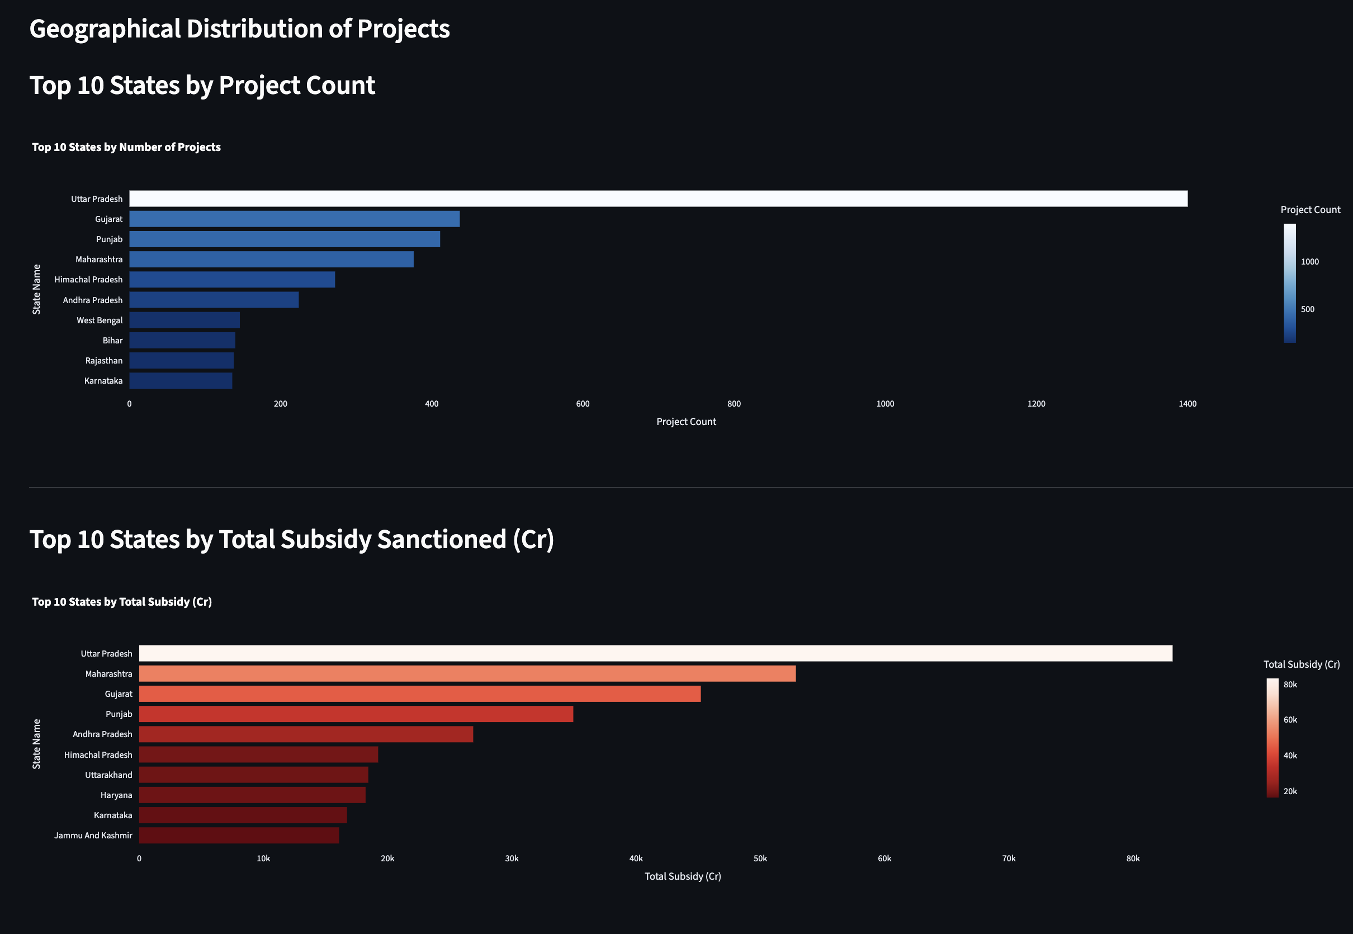

Slide 6
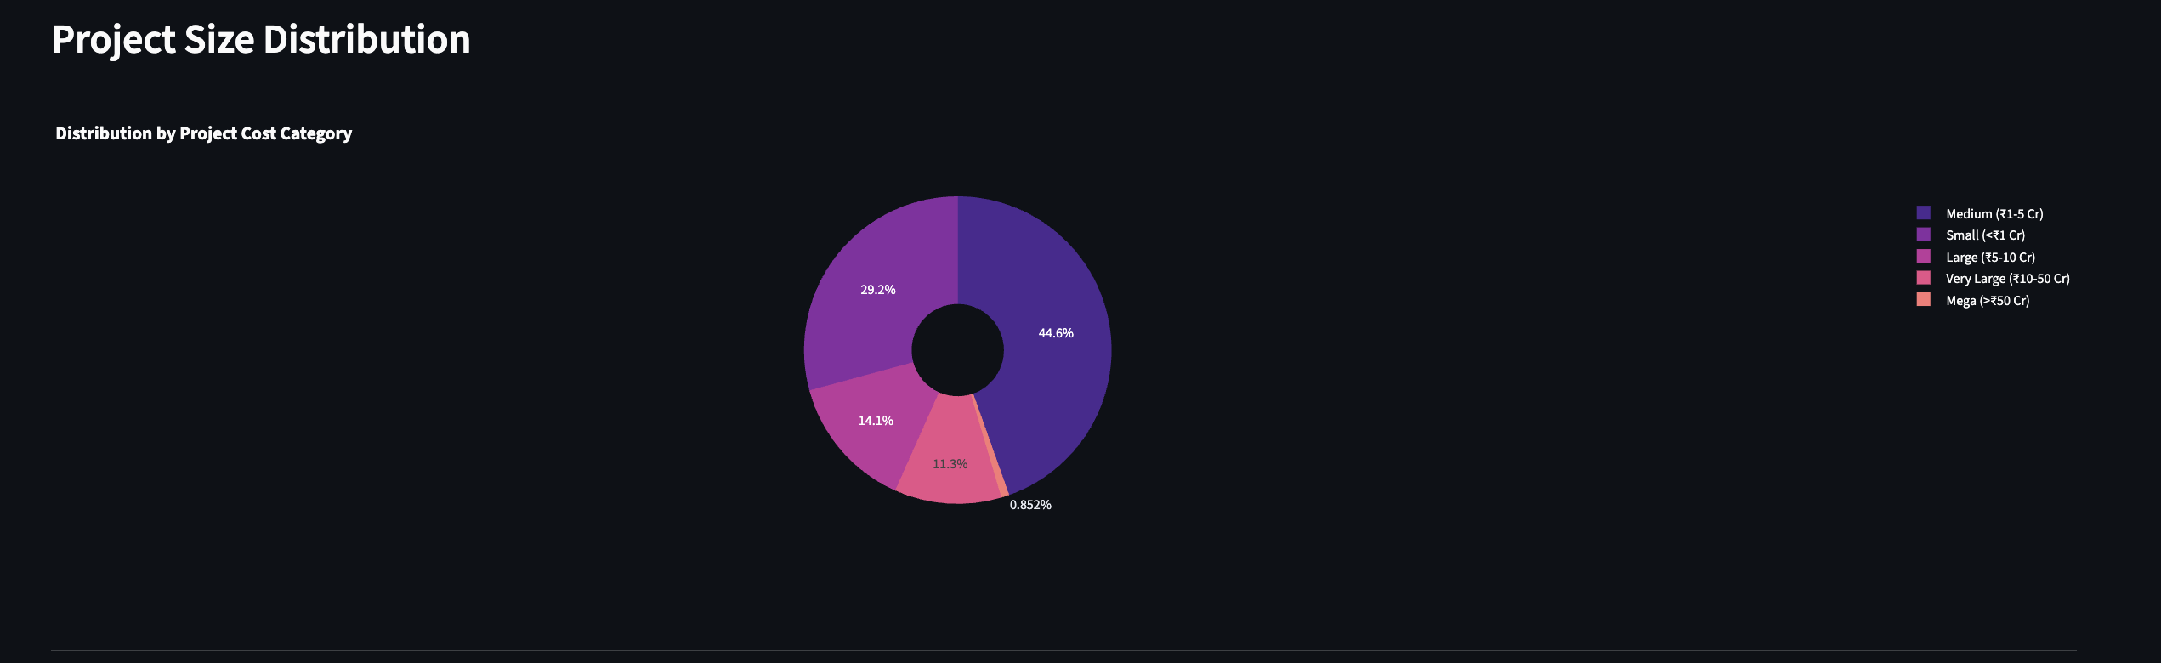
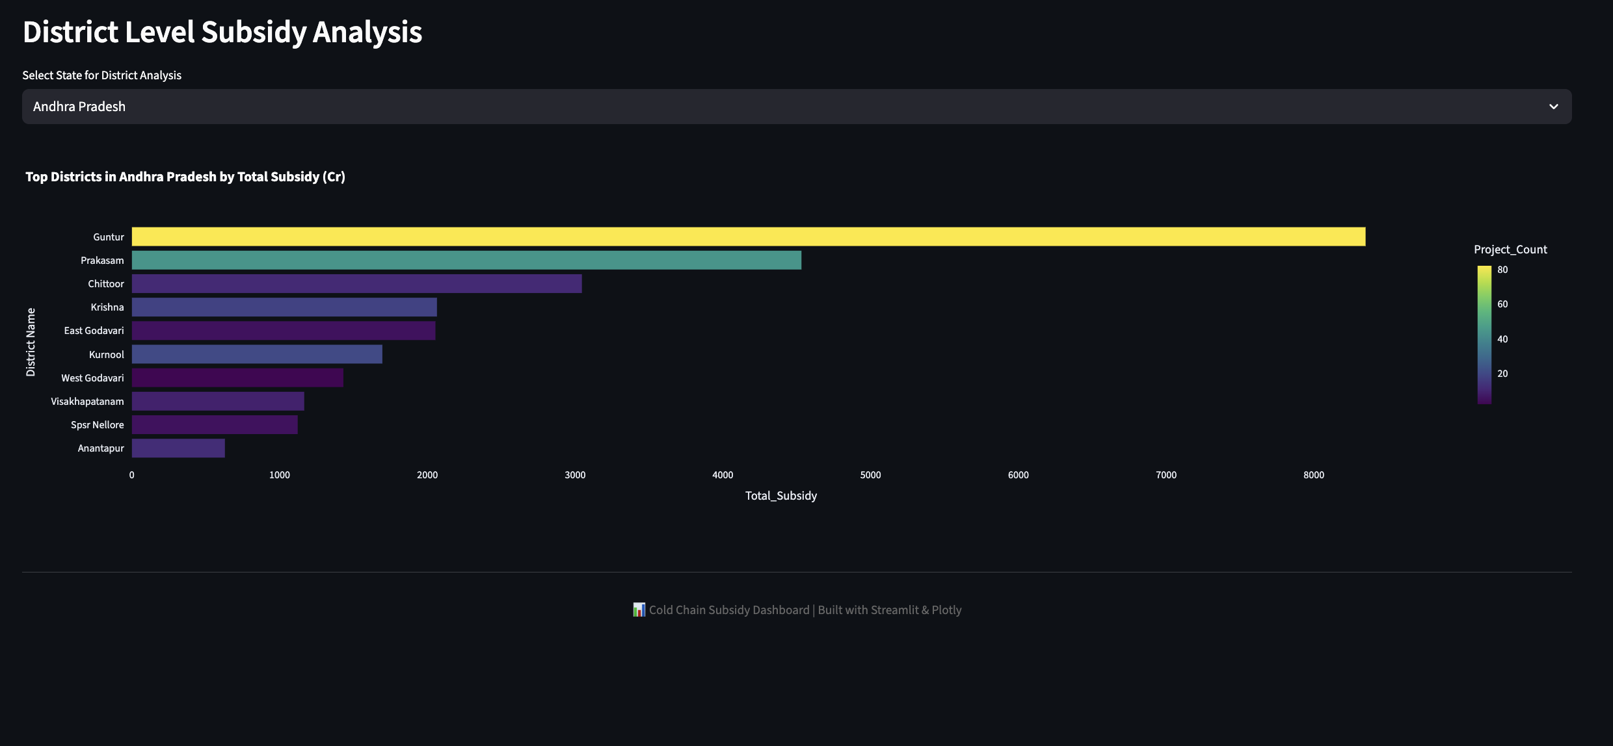

Slide 7
Investment Categories & Cost-Subsidy Relationship
Project Size Classification & Financial Patterns
Project Distribution: Medium projects (₹1–5 Cr) constitute 44.6%, small projects (<₹1 Cr) form 29.2%, and large projects (₹5–10 Cr) account for 14.1% of total analyzed investments.
Cost–Subsidy Correlation: A strong positive relationship exists, with most projects aligning around the 50% subsidy benchmark for eligible schemes.
Clustering Analysis: Three clear project clusters identified — small, medium, and large — reflecting diverse business scales and capital efficiency.
Financial Efficiency: Medium-scale projects demonstrate optimal investment-to-subsidy balance, providing high economic returns with limited fiscal dependency.
Strategic Insight: Medium projects are the backbone of India’s cold chain network, ensuring both scalability and financial sustainability.
Notes:
Analyzing project size and financial patterns provides deep insight into the economic dynamics of India’s cold chain investments. The data reveal that nearly 45% of all projects fall within the medium investment category, ranging from ₹1–5 Crores. This indicates that mid-scale enterprises are driving the majority of infrastructure growth.
The correlation between project cost and subsidy sanctioned is both strong and consistent, clustering around the 50% eligibility threshold. This trend signifies that government incentives are effectively proportional to project scale, promoting fairness and fiscal discipline.
From a business perspective, medium-scale projects represent the ideal balance between scalability and financial efficiency. They require manageable capital, achieve meaningful scale, and maintain steady profitability — making them the cornerstone of sustainable cold chain expansion.

Slide 8
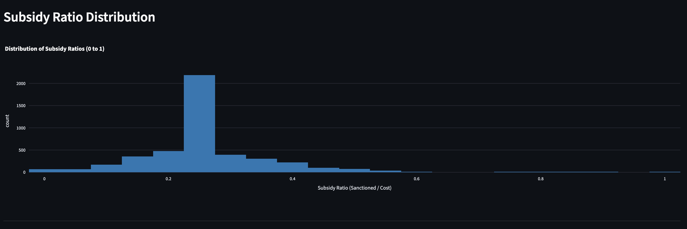
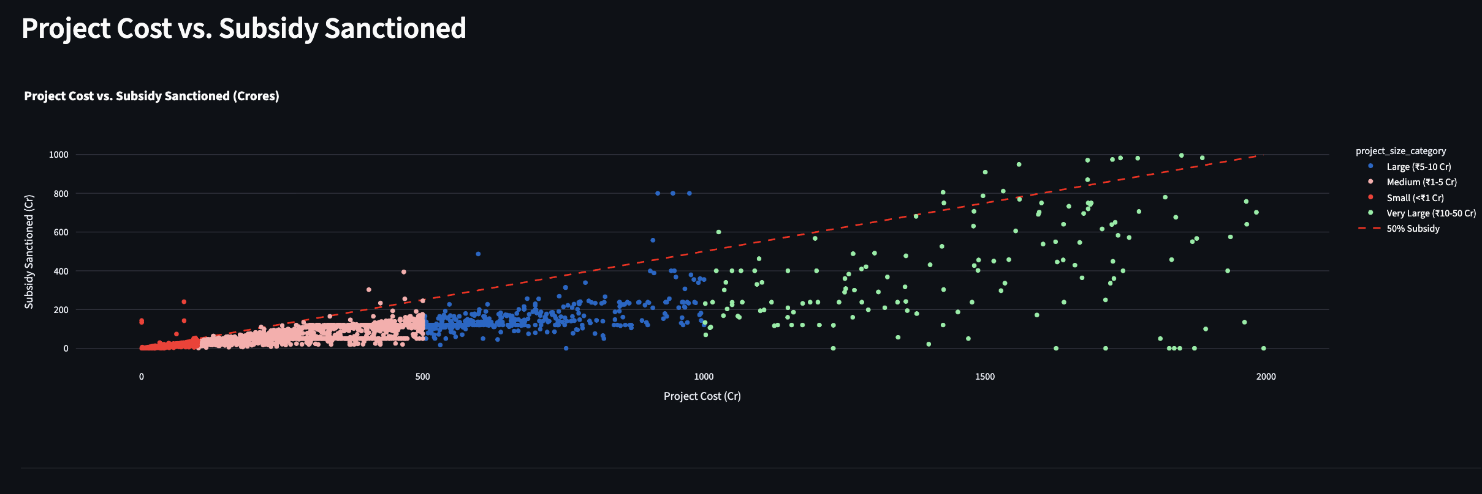

Slide 9
Machine Learning Model Results & Feature Importance
Predictive Model Performance
Model Performance: Achieved R² of 0.6625, explaining 66.25% of variance in subsidy allocation predictions, with an RMSE of ₹113.46 Crores.
Top Predictive Features: Project size category (Very Large, Mega), geographic location (Mizoram, Manipur, Nagaland), and state-specific factors like Arunachal Pradesh drive the model output.
Feature Interpretation: Feature importance analysis reveals that both project type and location strongly influence subsidy distribution efficiency.
Model Validation: Cross-validation confirms model robustness, ensuring minimal overfitting and reliable generalization on unseen project data.
Technical Insight: Regression-based models enable policymakers to forecast subsidy requirements and optimize budget allocation strategies.
Notes:
In this slide, we dive into the predictive modeling results that quantify the drivers behind subsidy allocation. Using a regression-based approach, the model achieved an R² score of 0.6625, explaining over two-thirds of the observed variation, with a Root Mean Square Error (RMSE) of ₹113.46 Crores — an acceptable range for macroeconomic prediction.
Feature importance analysis shows that project size categories such as ‘Very Large’ and ‘Mega’ projects significantly influence outcomes, while geographic features — notably from Northeastern states — also emerge as critical factors. This highlights regional disparities and the importance of localized policy interventions.
The model’s validation process demonstrates high reliability, meaning it can be practically deployed to predict future subsidy patterns. Such analytical tools offer great potential for optimizing government resource allocation in upcoming infrastructure programs.

Slide 10
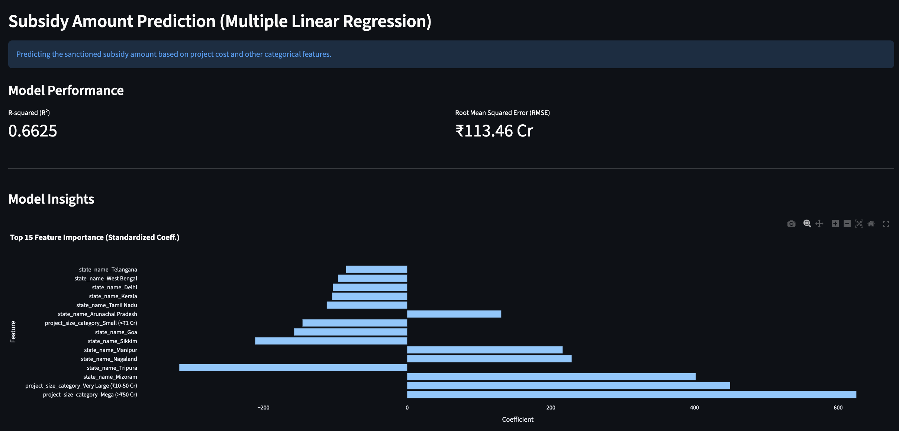

Slide 11
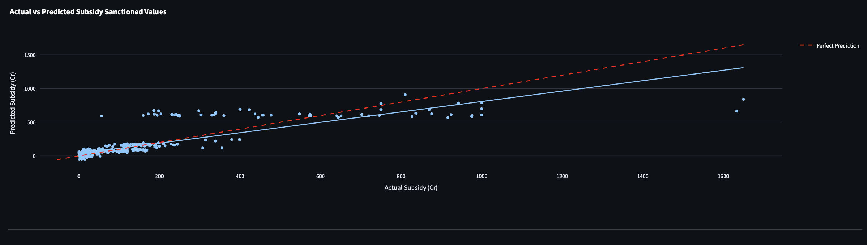
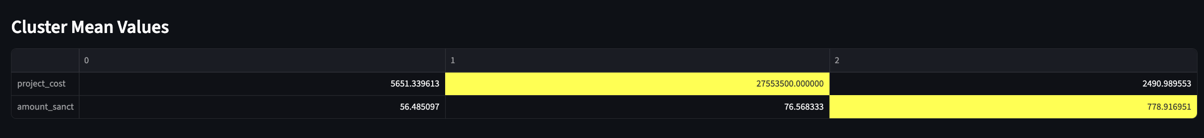

Slide 12
Strategic Insights & Future Outlook
Key Findings & Recommendations
Key Finding – Investment Peaks: Cold chain investments peaked during 2012–2013 policy initiatives, underscoring the role of government stimulus in driving growth.
Key Finding – Geographic Concentration: Most projects and subsidies are concentrated in agricultural states like Uttar Pradesh, Gujarat, and Punjab, creating regional imbalance.
Key Finding – Project Size Efficiency: Medium-scale projects (₹1–5 Cr) dominate with optimal financial performance and sustainable capital utilization.
Recommendation – Policy Focus: Revitalize post-2020 investment programs and expand geographic focus to eastern and southern regions for balanced development.
Recommendation – Predictive Planning: Leverage machine learning for data-driven subsidy planning, ensuring equitable distribution and efficient budget forecasting.
Notes:
This final slide synthesizes the analytical journey into key takeaways and actionable recommendations. The 2012–2013 period demonstrated that policy interventions are powerful catalysts for cold chain expansion. However, the spatial analysis revealed a significant imbalance—most growth is concentrated in a few agricultural states, leaving other regions underserved.
Medium-sized projects emerge as the most efficient investment class, balancing cost and output with minimal fiscal burden. Going forward, a renewed policy push is necessary to reignite post-2020 growth and distribute infrastructure more evenly across India.
Finally, the integration of machine learning into policy design offers an intelligent future direction—predictive analytics can enable transparent, fair, and optimized subsidy allocation, ensuring that India’s cold chain ecosystem continues to scale efficiently and sustainably.

